Slide 1

Research Progress Record
Enmao Diao
Oct 31, 2018

Slide 2
Abstract
Computation
Data
Compression and Classification
Codec Conversion
Milestones

Slide 3
Last Milestones
General
✓ Set up GPU computation environment at Duke Cluster Computing
Better tuning parameter strategy for optimization
Setting a milestone for each objective and adjust tuning parameter based on the distance between the milestone and the current performance
Test on multi-stage optimization
✓ First train on compression and then classification
✓ First train on one dataset and then test and train on another

Slide 4
Last Milestones
Compression and Classification
✗ Further Test forward and backward connection (less important)
✓ Further test sum of residual loss
✓ Further test difference of patches patch-based network
✓ Explore on overlapping patches and patch sequence formation
✓ Test on ImageNet and COCO dataset
✓ Test on larger patch size i.e. 128x128
✓ Experiment variable depth model. So far we have 4 compression module at encoder and 4 at decoder. Compression rate is 1/16 for each residual iteration
✓ Test on multi-scale codec
✓ Test on pixel unshuffled model
✓ Test on dynamic depth and iteration size model
✓ Merge into one
✓ Explore memory issue
✗ Experiment variable code size for different images? May depend on entropy codec?
✓ Experiment with more slave nodes
Experiment asynchronous distributed system

Slide 5
Last Milestones
Codec Conversion
✓ Searching for source code for JPG and its entropy codec
Experiment conversion between classical codecs like JPG JPG2000 BPG (lossy) and PNG BMP (lossless)
✗Explore different size of codes for different images
Experiment conversion between codecs trained on different dataset
Experiment conversion between trained codecs and classical codecs

Slide 6
Last Milestones
Other tracks
✓ Explore generative model and experiment a variational model for binary autoencoder. Generative model is suitable for change detection and other inference tasks. Gumbel Softmax trick can be a good start
✓ Set up MS COCO dataset for Detection task and explore detection and caption in addition to compression and classification

Slide 7
Computation
4 NVIDIA TITAN XP roughly better than two P10 at Microsoft Azure
12GB memory each, smaller than one P10 but two larger than one P10
For Joint model, one epoch takes 600s
✓ Set up GPU computation environment at Duke Cluster Computing

Slide 8
Data
MNIST dataset
60000 handwritten 0-9 digits images for training, 10000 for test
Original shape 28x28, resized to 32x32
CIFAR10 dataset (cannot exceed 30 PSNR and 74% accuracy)
50000 natural images of 10 classes like airplane, automobile, cat, dog, etc for training, 10000 for test
Original shape 32x32
SVHN dataset
Street View House Numbers data containing 0-9 digits RGB cropped images. 73257 digits for training, 26032 digits for testing, and 531131 additional (not used this time), somewhat less difficult samples, to use as extra training data.
http://ufldl.stanford.edu/housenumbers/

Slide 9
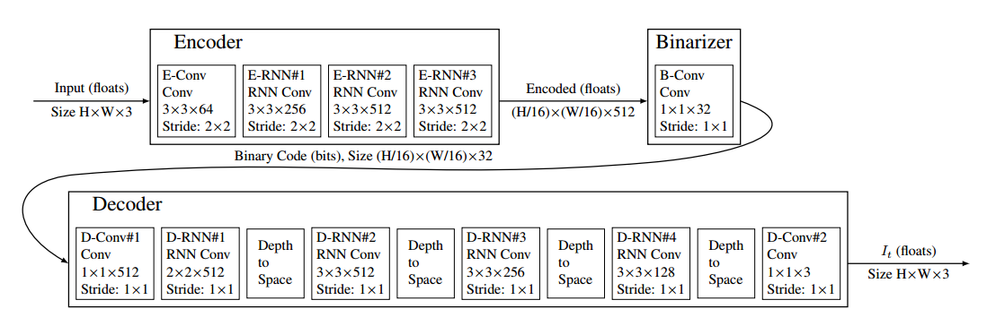
Model
Google Model

Slide 10
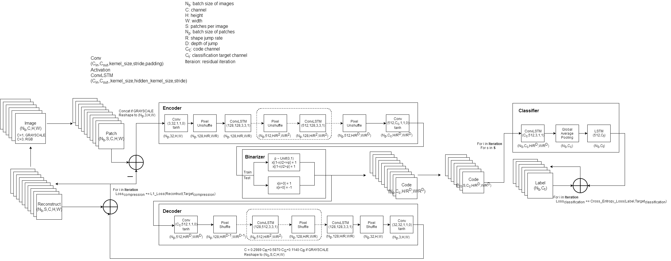
Model

Slide 11
Compression and Classification
Test on multi-stage optimization
✓ First train on compression and then classification
Training with only classification error failed
Training with tuning parameter works but converge to worse point
Performance is related to tuning parameter and learning rate
Maybe valid if we have better tuning parameter and learning rate adjustment method

Slide 12
Compression and Classification
Test on multi-stage optimization
✓ First train on one dataset and then test and train on another
First train on one dataset(MNIST/SVHN) untile converge, then train on another dataset(SVHN/MNIST) until converge
The model still performs better than random noise
If we have more and more dataset, then the first trained dataset might be forgotten
Related to transfer learning
Learning rate sensitive
How to remember different dataset?
Retrain/Flashback summarized data
Add hidden and memory cell for the whole model

Slide 13
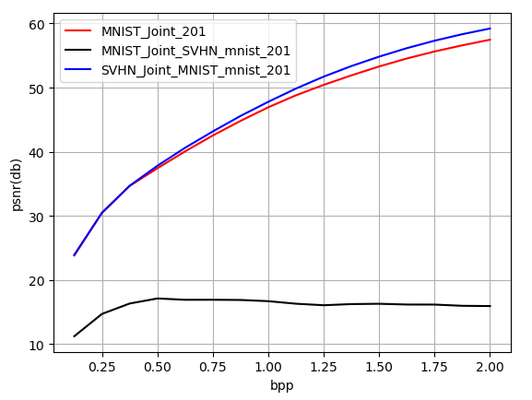
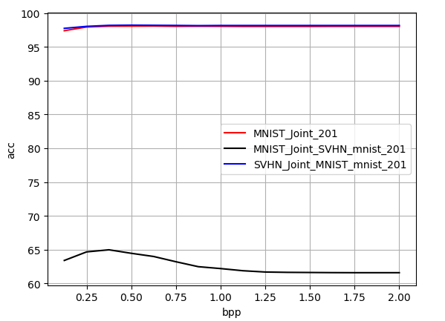
Compression and Classification
Test on multi-stage optimization
✓ First train on one dataset and then test and train on another

Slide 14
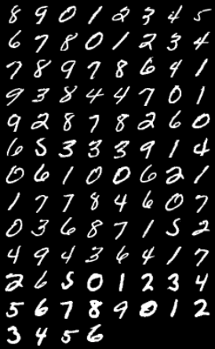

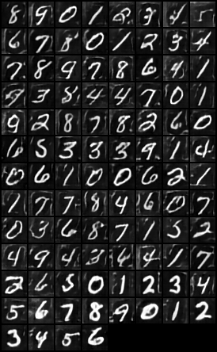

Compression and Classification
Test on multi-stage optimization
✓ First train on one dataset and then test and train on another
Original MNIST MNIST_SVHN_mnist SVHN_MNIST _mnist

Slide 15
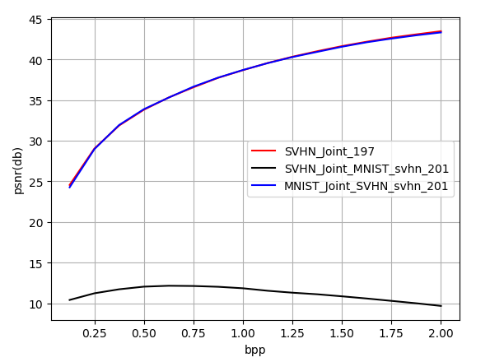
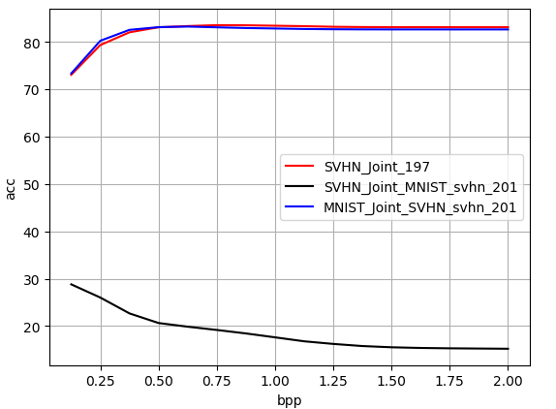
Compression and Classification
Test on multi-stage optimization
✓ First train on one dataset and then test and train on another

Slide 16
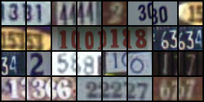

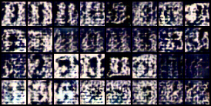

Compression and Classification
Test on multi-stage optimization
✓ First train on one dataset and then test and train on another
Original SVHN SVHN_MNIST_svhn MNIST_SVHN_svhn

Slide 17
Compression and Classification
✓ Further test sum of residual loss
Improves AUC a little, but may due to randomness
✓ Further test difference of patches patch-based network
Not improve the results
✓ Explore on overlapping patches and patch sequence formation
Improve a little but create more data need to train (computation increases)
Patches feed as batches into codec but as sequence into classifier (valid performance)

Slide 18
Compression and Classification
✓ Test on ImageNet and COCO dataset
Can only test with batch_size = 1, Memory issue
✓ Test on larger patch size i.e. 128x128
Larger patch size reduces computation cost because less batch size data are generated
Larger patch size also increases performance
Need to test with deep models with ImageNet
✓ Experiment variable depth model. So far we have 4 compression module at encoder and 4 at decoder. Compression rate is 1/16 for each residual iteration
Test model with different depth (2,3,4,5)

Slide 19
Compression and Classification
✓ Test on multi-scale codec
Inspired by depth-variant model, code from larger scale may also improve the result.
Scale for compression and classification may not be the same
Slightly more computation cost than normal model
So far only compression result is retrieved (can achieve 60 dB with same bpp), classification model is limited by the shape of different scales of code
Need to test with MS-SSIM metric and compare with normal model
So far only compression model, can achieve about 60db on MNIST dataset

Slide 20
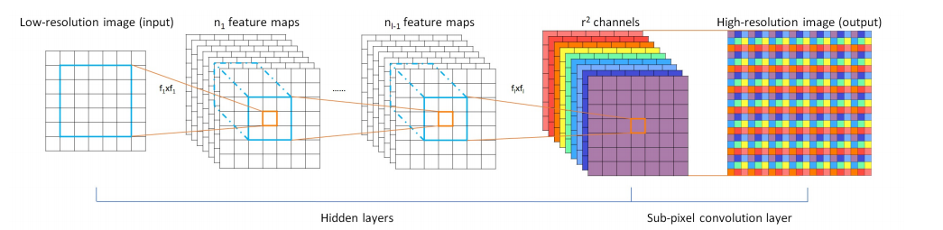
Compression and Classification
✓ Test on pixel unshuffled model
Previously, Google model only use Pixel shuffle for upsampling and thus the model is not uniform
Now model is uniform and performs better than Google model

Slide 21
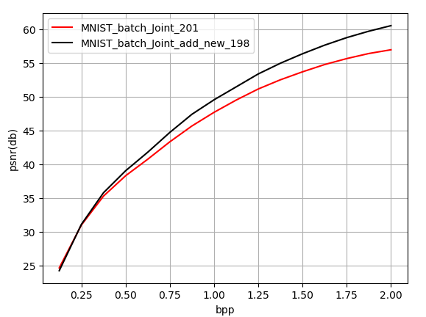
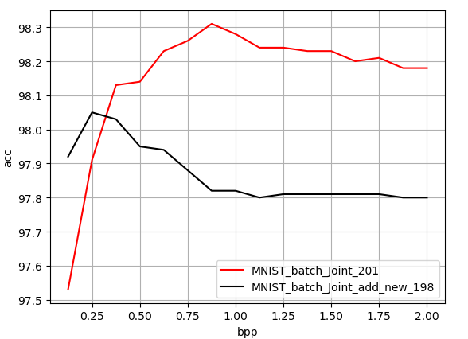
Compression and Classification
✓ Test on pixel unshuffled model
Previously, Google model only use Pixel shuffle for upsampling and thus the model is not uniform
Now model is uniform and performs better than Google model

Slide 22
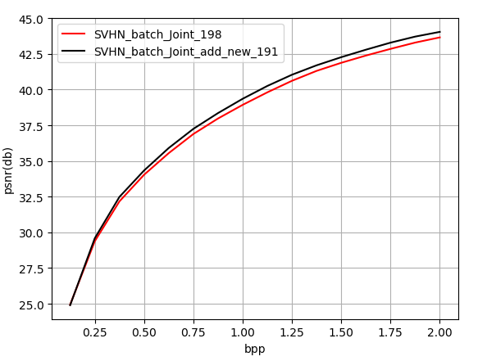
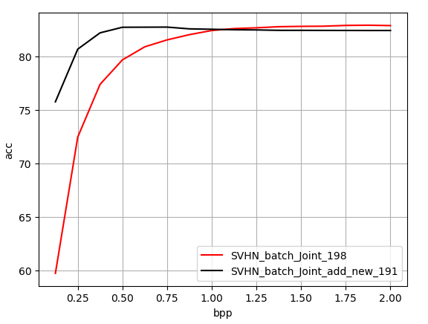
Compression and Classification
✓ Test on pixel unshuffled model

Slide 23
Compression and Classification
✓ Test on dynamic depth and iteration size model
After maximum depth and maximum iteration are specified, the depth and residual iteration of model can be variant while training and testing
✓ Merge into one
So far, our model can handle any batch of images with same size (even number of pixels of width and height), training with dynamic patch size, depth, residual iteration

Slide 24
Compression and Classification
✓ Explore memory issue
Clean up hidden state after compression and classification module
Need to test with small channel size
Need to test with GRU unit
One residual iteration only consumes no more than 3GB memory but 16 residual iterations can consumes 11GB
Need to test Truncated BPTT
Need to test with no memory module

Slide 25
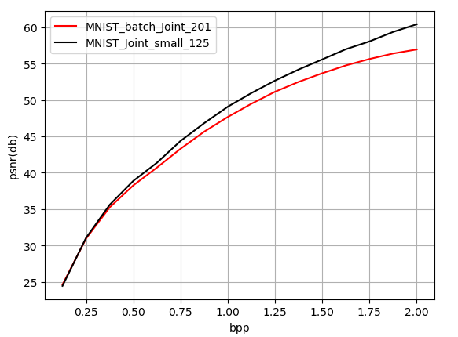
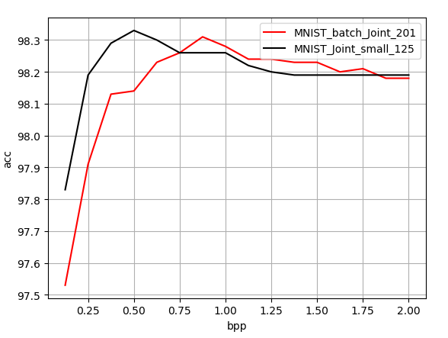
Compression and Classification
✓ Explore memory issue
Smaller model

Slide 26
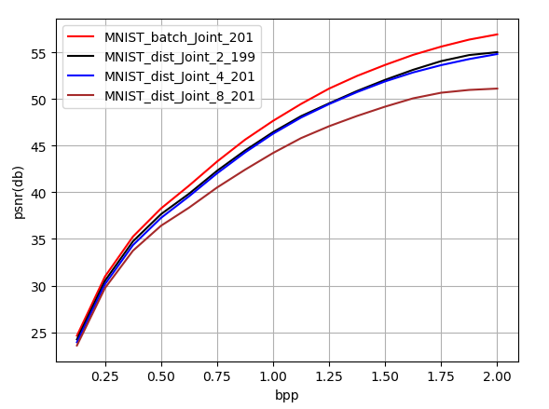
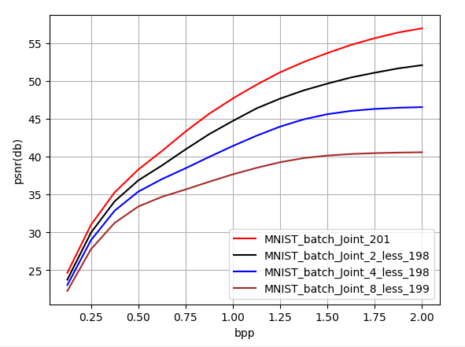
Compression and Classification
✓ Experiment with more slave nodes
When encode, decoder is also involved to generate codes from residuals. It still works but it might not be valid for residual based model?
Test with different slave nodes and compare with training with subset of data

Slide 27
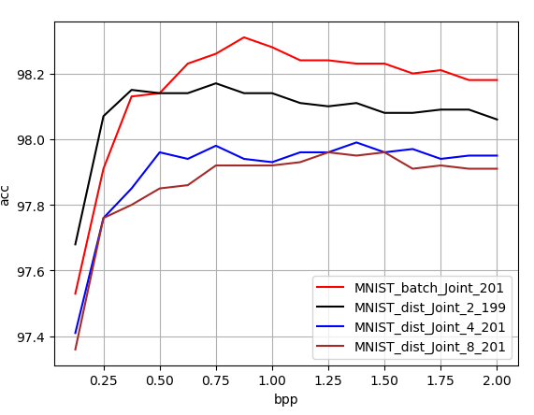
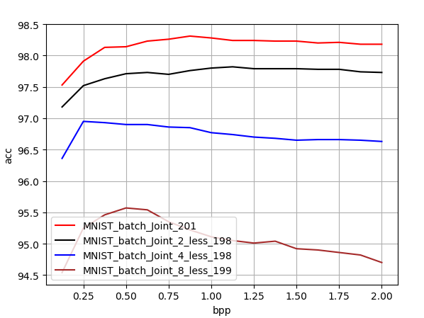
Compression and Classification
✓ Experiment with more slave nodes

Slide 28
Codec Conversion
✓ Searching for source code for JPG and its entropy codec
✓ Experiment conversion between codecs trained on the same and different dataset
Two slightly different models trained on the same dataset. Result is not good and only achieve 20dB.

Slide 29
Other Tracks
✓ Explore generative model and experiment a variational model for binary autoencoder. Generative model is suitable for change detection and other inference tasks. Gumbel Softmax trick can be a good start
Variational Auto Encoder (VAE) is suitable for unsupervised classification based on our data visualization
Exploring K-means and GMM on clustering VAE
Exploring concrete distribution (using Gumbel Softmax) VAE

Slide 30
Other Tracks
✓ Set up MS COCO dataset for Detection task and explore detection and caption in addition to compression and classification
Data loader verified but need improvement
Find several source code for Faster-RCNN but most of them have complicated structured code
Adapting Faster-RCNN with our model framework

Slide 31
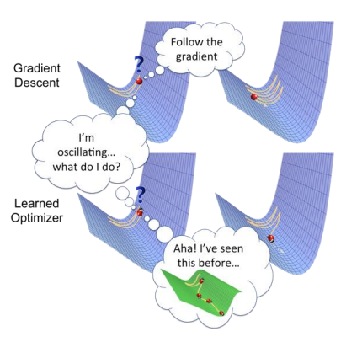
Milestones
General
Better tuning parameter strategy for optimization
Setting a milestone for each objective and adjust tuning parameter based on the distance between the milestone and the current performance
https://arxiv.org/pdf/1810.04650v1.pdf
Meta Learning
Use models to learn the learning rate and other hyper parameters (learn to learn)
Transfer Learning
Add hidden and memory state for the whole model
Growing Memory cell
Memory Issue
Test Truncated BPTT and models that consume less memory

Slide 32
Milestones
Compression and Classification
Experiment better classification performance
Test on ImageNet and Coco Dataset after memory issue fixed
Try to add support for varying image size
Test with large image shape with deeper models with ImageNet
Test with Kodak and RAID (raw images) dataset
Test with other metrics and PSNR-HVS and MS-SSIM
Add entropy codec and Compare with other classical codecs like JPG2000, BPG
Test dynamic functionality and performance
Test more multi-scale model
Test distributed codecs with smaller encoders
Test decoders for different number of nodes
Experiment smaller gap among the number of nodes
Experiment images from different angle for distributed systems
Start Video Compression

Slide 33
Milestones
Codec Conversion
Experiment conversion between classical codecs like JPG JPG2000 BPG (lossy) and PNG BMP (lossless)
Only find C code for JPG2000 (wavelet compression)
Experiment conversion between trained codecs and classical codecs

Slide 34
Milestones
Generative Codec and unsupervised learning
Experiment K-means and GMM for MNIST data with Gaussian VAE
Experiment Dirichlet Process GMM for gradually growing number of clusters (dictionary building)
Experiment Concrete VAE (Bernoulli distribution reparametrized by Gumbel Trick)
Combine Clustering, Concrete VAE and our codecs

Slide 35
Milestones
Compression and Detection
Combine Faster-RCNN with our codecs

Slide 36
Milestones
Other Tracks
Audio Compression, Music Information Retrieval and Speech Recognition
Web Crawler for crawling images from URL (data mining)

